Slide 1
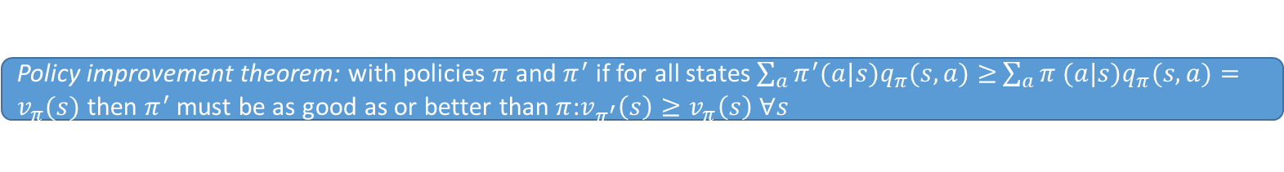
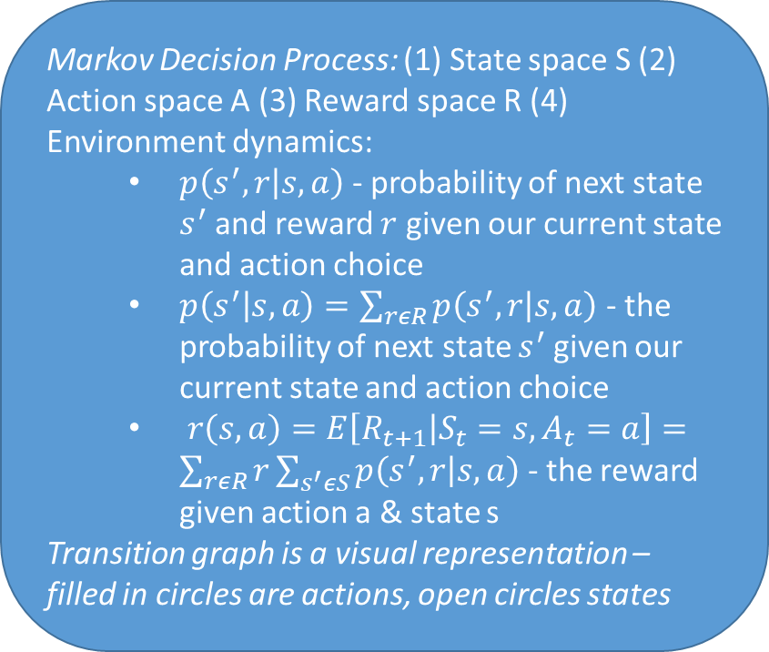
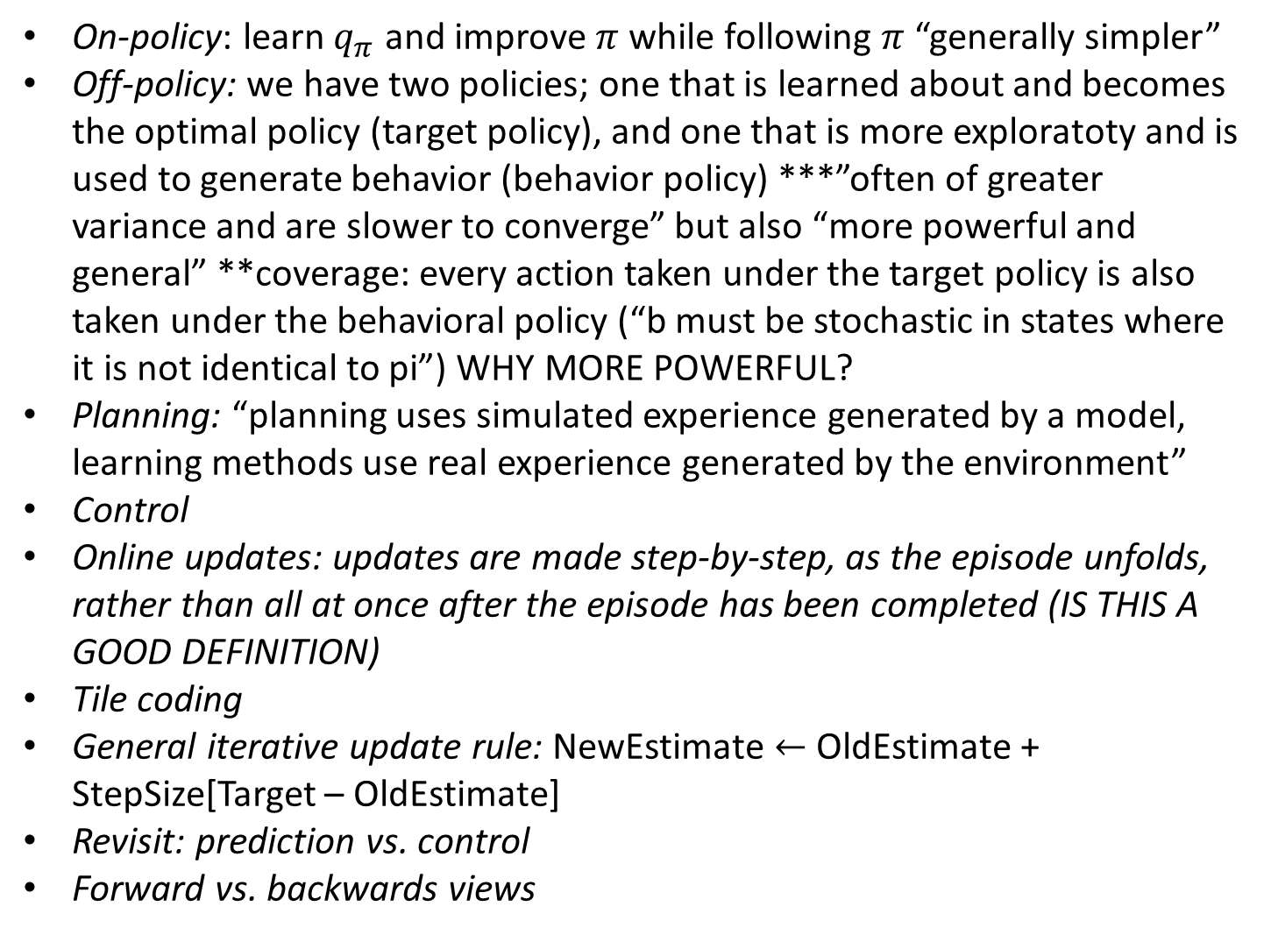
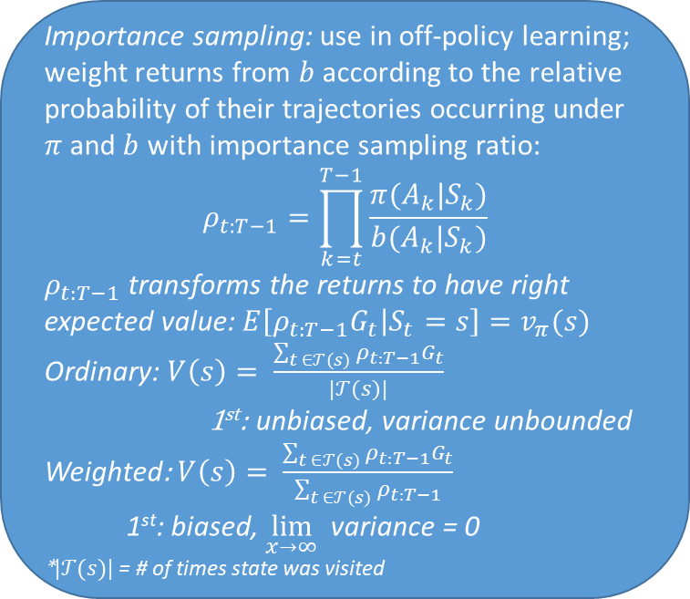
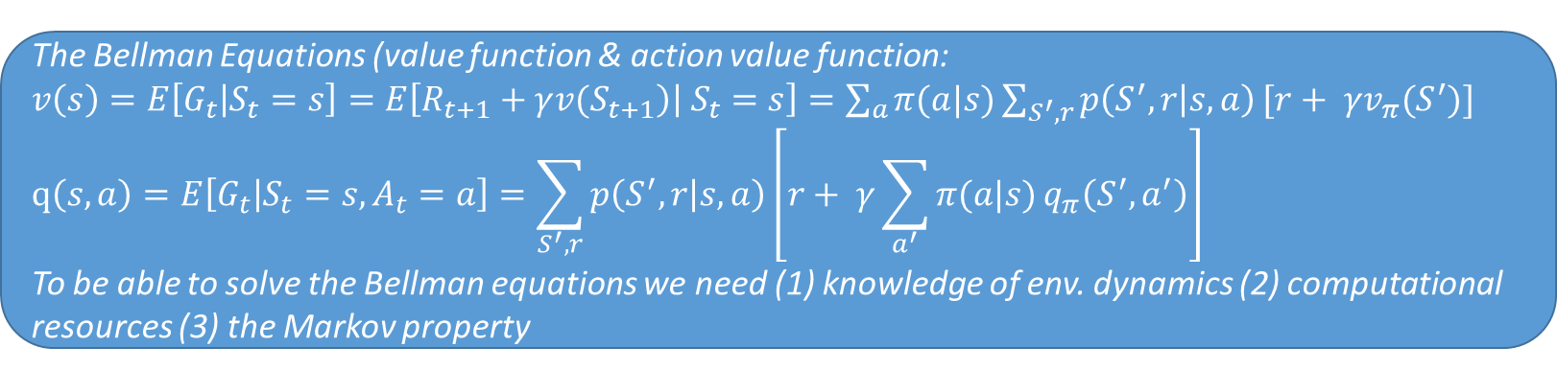
Exploration vs. exploitation
Markov property $\operatorname{Pr}\left\{S_{t+1},R_{t+1} | S_{t},A_{t},…,S_{0}A_{0}\right\}=\operatorname{Pr}\left\{S_{t+1},R_{t+1} | S_{t},A_{t} \right\}$
Markov Decision Process: (1) State space S (2) Action space A (3) Reward space R (4) Environment dynamics:
  $p\left(s^{′},r | s,a\right)$ - probability of next state $s^{′}$ and reward $r$ given our current state and action choice
  $p\left(s^{′} | s,a\right)=\sum_{rεR}{p\left(s^{′},r | s,a\right)}$ - the probability of next state $s^{′}$ given our current state and action choice
  $r\left(s,a\right)=E\left[R_{t+1} | S_{t}=s, A_{t}=a\right]=\sum_{rεR}{r}\sum_{s^{′}εS}{p\left(s^{′},r | s,a\right)}$ - the reward given action a & state s
Transition graph is a visual representation – filled in circles are actions, open circles states
The Bellman Equations (value function & action value function:
$v\left(s\right)=E\left[G_{t} | S_{t}=s\right]=E\left[R_{t+1}+γ{v(S}_{t+1}\right)\left| S_{t}=s\right]=\sum_{a}{π(a|s)\sum_{S^{′},r}{p\left(S^{′},r | s,a\right)}}[r+ γv_{π}(S^{′})]$
$$q\left(s,a\right)=E\left[G_{t} | S_{t}=s,A_{t}=a\right]=\sum_{S^{′},r}{p\left(S^{′},r | s,a\right)}\left[r+ γ\sum_{a^{′}}{π(a|s)}q_{π}\left(S^{′},a^{′}\right)\right]$$
To be able to solve the Bellman equations we need (1) knowledge of env. dynamics (2) computational resources (3) the Markov property
Without a model state values alone are not sufficient. One must explicitly estimate the value of each action in order for the values to be useful in suggesting a policy
Policy evaluation: compute the values of states under current policy (can do iteratively until convergence)
Policy improvement: make policy greedy wrt state values from policy evaluation
All learning control methods face a dilemma: they seek to learn action values conditional on subsequent optimal behavior, but they need to behave non-optimally in order to explore all actions (to find the optimal action). Enter: off-policy methods
Generalized policy iteration: the process of policy evaluation (assumes policy known) followed by policy improvement (assumes value of states known); when neither process results in changes to the other, the policy is optimal
Policy improvement theorem: with policies $π$ and $π^{′}$ if for all states $\sum_{a}{π^{′}(a|s)q_{π}(s,a)≥}\sum_{a}{π (a|s)q_{π}(s,a)}=v_{π}(s)$ then $π^{′}$ must be as good as or better than $π$:$v_{π^{′}}\left(s\right)≥v_{π}\left(s\right) ∀s$
On-policy: learn $q_{π}$ and improve $π$ while following $π$ “generally simpler”
Off-policy: we have two policies; one that is learned about and becomes the optimal policy (target policy), and one that is more exploratoty and is used to generate behavior (behavior policy) ***”often of greater variance and are slower to converge” but also “more powerful and general” **coverage: every action taken under the target policy is also taken under the behavioral policy (“b must be stochastic in states where it is not identical to pi”) WHY MORE POWERFUL?
Planning: “planning uses simulated experience generated by a model, learning methods use real experience generated by the environment”
Control
Online updates: updates are made step-by-step, as the episode unfolds, rather than all at once after the episode has been completed (IS THIS A GOOD DEFINITION)
Tile coding
General iterative update rule: NewEstimate $←$ OldEstimate + StepSize[Target – OldEstimate]
Revisit: prediction vs. control
Forward vs. backwards views
Discount rate $γ$: low = shortsighted; high = farsighted
Bootstrapping: updating estimates based on other estimates
Importance sampling: use in off-policy learning; weight returns from $b$according to the relative probability of their trajectories occurring under $π$and $b$ with importance sampling ratio:
$$ρ_{t:T−1}=\prod_{k=t}^{T−1}{\frac{π(A_{k}|S_{k})}{b(A_{k}|S_{k})}}$$
$ρ_{t:T−1}$ transforms the returns to have right expected value: $E\left[ρ_{t:T−1}G_{t} | S_{t}=s\right]=v_{π}(s)$
Ordinary: $V\left(s\right)= \frac{\sum_{t ∈𝒯(s)}{ρ_{t:T−1}}G_{t}}{|𝒯(s)|}$
1st: unbiased, variance unbounded
Weighted: $V\left(s\right)= \frac{\sum_{t ∈𝒯(s)}{ρ_{t:T−1}}G_{t}}{\sum_{t ∈𝒯(s)}{ρ_{t:T−1}}}$
  1st: biased, $\lim_{x→∞}{ }$variance = 0
*$|𝒯(s)|$ = # of times state was visited
The deadly triad: instability and divergence typically result from the combination of (1) function approximation (2) bootstrapping (3) off-policy training

Slide 2
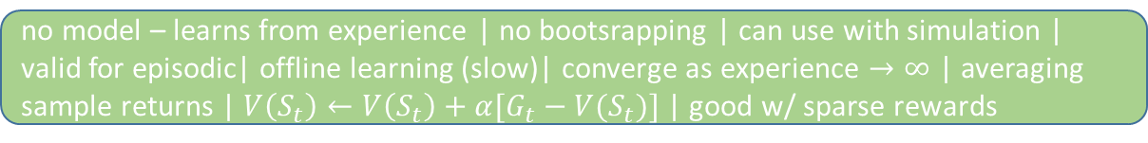
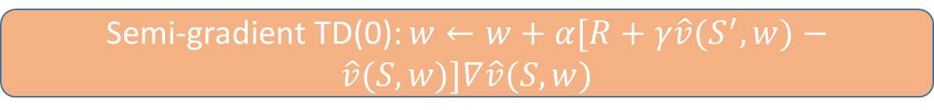
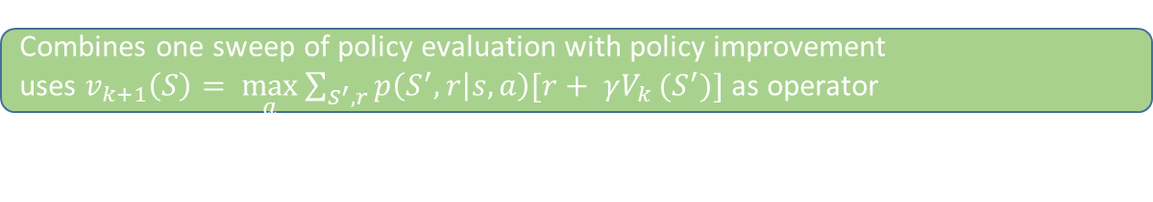
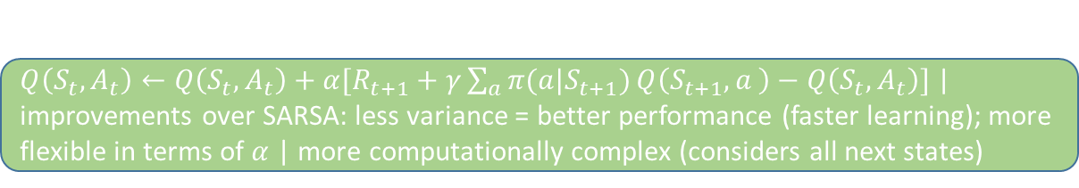
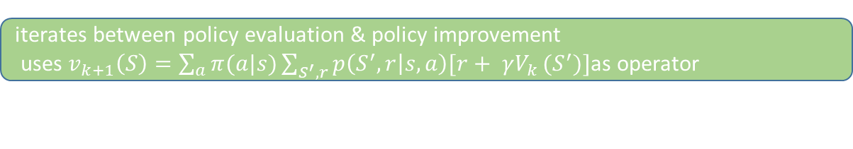
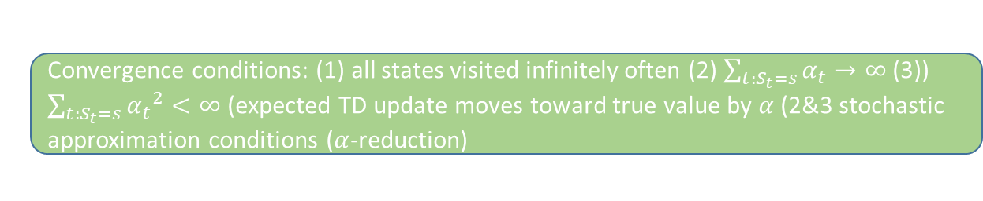
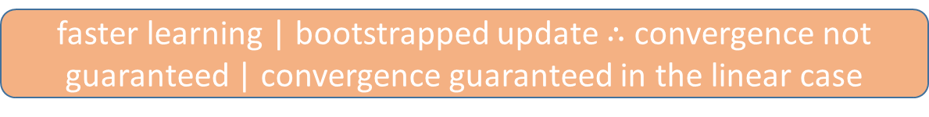
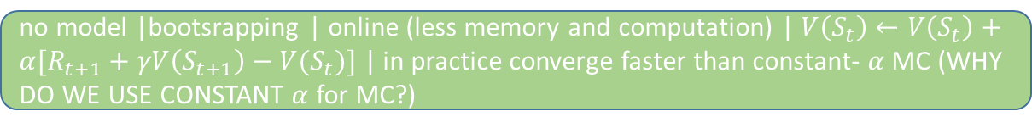
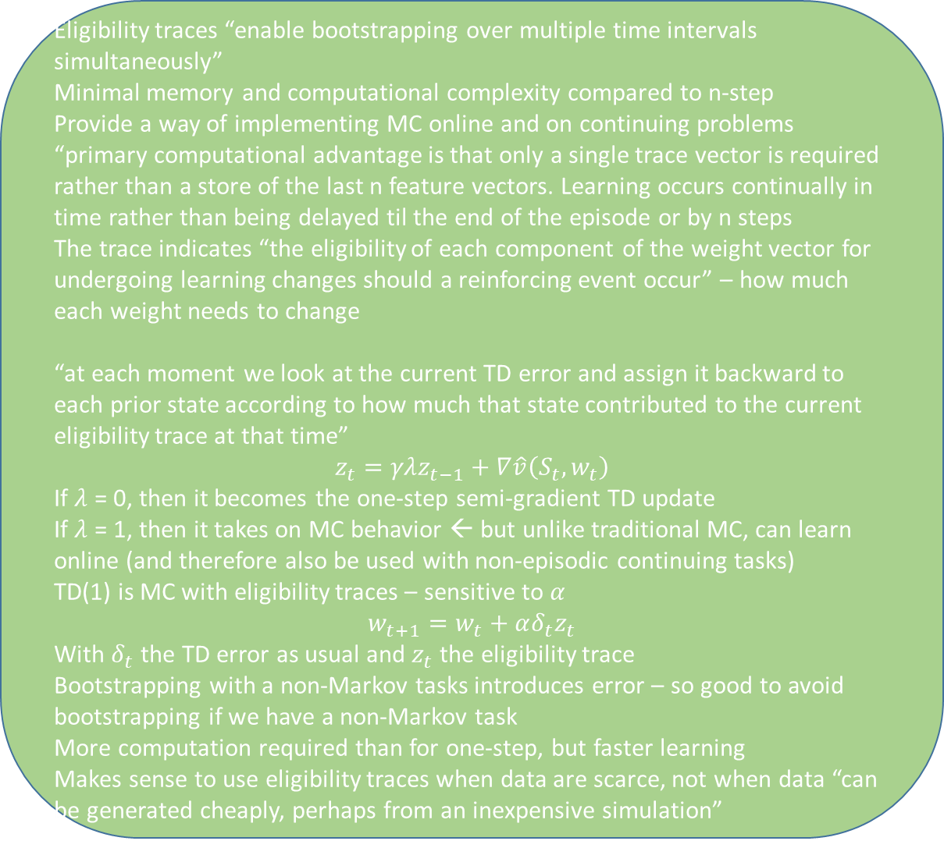
Tabular Methods
Function Approximation
“a powerful, scalable way of generalizing from a state space much larger than the memory and computational resources”
Dynamic Programming
Value Function Approximation
bootstrapping method | requires model of env. $p\left(s^{′},r | s,a\right)$ | convergence proofs
Policy iteration
iterates between policy evaluation & policy improvement
uses $v_{k+1}\left(S\right)=\sum_{a}{π(a|s)}\sum_{S^{′},r}{p\left(S^{′},r | s,a\right)[r+ γV_{k }(S^{′})]}$as operator
When: high dimensionality of state space
Value iteration
Stochastic-gradient methods
Combines one sweep of policy evaluation with policy improvement
uses $v_{k+1}\left(S\right)= \max_{a}{\sum_{S^{′},r}{p\left(S^{′},r | s,a\right)[r+ γV_{k }(S^{′})]}}$ as operator
Gradient MC update: $w←w+α[G_{t}−\hat{v}(S_{t},w)]∇\hat{v}(S_{t},w)$
Monte Carlo
Convergence guaranteed with α decreasing
no model – learns from experience | no bootsrapping | can use with simulation | valid for episodic| offline learning (slow)| converge as experience $→∞$ | averaging sample returns | $V\left(S_{t}\right)←V\left(S_{t}\right)+α[G_{t}−V(S_{t})]$ | good w/ sparse rewards
Semi-gradient methods
Advtantages of n-step TD over one step : One step TD: “in many applications one wants to be able to update the action very fast to take into account anything that has changed, but bootstrapping works best if it is over a length of time in which a significant and recognizable state change has occurred”
Semi-gradient TD(0): $w←w+α[R+γ\hat{v}(S^{′},w)−\hat{v}(S,w)]∇\hat{v}(S,w)$
We may not visit every state-action pair – in order to maintain exploration we can have (1) exploring starts (every state-action pair has a nonzero probability of being selected as the start – not realisitic – any other cons??) (2) e-soft policies ( most of the prob. on the optimal a; some nonzero prob. on other a) (3) off policy
faster learning | bootstrapped update $∴$ convergence not guaranteed | convergence guaranteed in the linear case
Experience contains every time that the state was visited | “every-visit methods are often preferred because they remove the need to keep track of which states have been visited and because they are much easier to extend to approximations”
MC First Visit
TD(λ)
Advantages of TD over MC: “some MC methods must ignore or discount episodes on which experimental actions are taken, which can greatly slow learning. TD methods are much less susceptible to these problems because they learn from each transition regardless of what subsequent actions are taken”
MC Every Visit
Temporal Difference
Eligibility traces “enable bootstrapping over multiple time intervals simultaneously”
Minimal memory and computational complexity compared to n-step
Provide a way of implementing MC online and on continuing problems
“primary computational advantage is that only a single trace vector is required rather than a store of the last n feature vectors. Learning occurs continually in time rather than being delayed til the end of the episode or by n steps
The trace indicates “the eligibility of each component of the weight vector for undergoing learning changes should a reinforcing event occur” – how much each weight needs to change
“at each moment we look at the current TD error and assign it backward to each prior state according to how much that state contributed to the current eligibility trace at that time”
$$z_{t}=γλz_{t−1}+∇\hat{v}\left(S_{t},w_{t}\right)$$
If $λ$ = 0, then it becomes the one-step semi-gradient TD update
If $λ$ = 1, then it takes on MC behavior ← but unlike traditional MC, can learn online (and therefore also be used with non-episodic continuing tasks)
TD(1) is MC with eligibility traces – sensitive to $α$
$$w_{t+1}=w_{t}+αδ_{t}z_{t}$$
With $δ_{t}$ the TD error as usual and $z_{t}$ the eligibility trace
Bootstrapping with a non-Markov tasks introduces error – so good to avoid bootstrapping if we have a non-Markov task
More computation required than for one-step, but faster learning
Makes sense to use eligibility traces when data are scarce, not when data “can be generated cheaply, perhaps from an inexpensive simulation”
no model |bootsrapping | online (less memory and computation) | $V\left(S_{t}\right)←V\left(S_{t}\right)+α[R_{t+1}+γV\left(S_{t+1}\right)−V(S_{t})]$ | in practice converge faster than constant- $α$ MC (WHY DO WE USE CONSTANT $α$ for MC?)
Advantages of MC over DP: don’t need to know a model of the env., can use with simulation/sample models, can focus on small subsets of the states: “a region of special interest can be accurately evaluated without going to the expense of accurately evaluating the rest of the state set, MAY BE LESS HARMED BY VIOLATIONS OF THE MARKOV PROPERTY BECAUSE THEY DO NOT BOOTSTRAP
Convergence conditions: (1) all states visited infinitely often (2) $\sum_{t:S_{t}=s}{α_{t}→∞}$ (3)) $\sum_{t:S_{t}=s}{{α_{t}}^{2}}<∞$ (expected TD update moves toward true value by $α$ (2&3 stochastic approximation conditions ($α$-reduction)
SARSA
On-policy | $Q\left(S_{t},A_{t}\right)←Q\left(S_{t},A_{t}\right)+α[R_{t+1}+γQ\left(S_{t+1},A_{t+1}\right)−Q\left(S_{t},A_{t}\right)]$ | appears particularly sensitive to $α$
Dynamic Programming
Value iteration – policy improvement and truncated policy evaluation (evaluation stopped after one update of each state)
alternates between two phases (1) policy evaluation (2) policy improvement
Bootstrapping method
Looks like an alternative to directly solving the bellman equations – instead we iteratively compute state values under the policy
Will eventually converge – so we stop when there are no more changes to the values (once we’ve converged)
Q Learning
Policy Gradient Methods
off-policy | $Q\left(S_{t},A_{t}\right)←Q\left(S_{t},A_{t}\right)+α[R_{t+1}+\max_{a}{Q\left(S_{t+1},a \right)}−Q\left(S_{t},A_{t}\right)]$
Expected SARSA
$Q\left(S_{t},A_{t}\right)←Q\left(S_{t},A_{t}\right)+α[R_{t+1}+γ\sum_{a}{π(a|S_{t+1})}Q\left(S_{t+1},a \right)−Q\left(S_{t},A_{t}\right)]$ | improvements over SARSA: less variance = better performance (faster learning); more flexible in terms of $α$ | more computationally complex (considers all next states)
n-step methods
Uses $G_{t:t+n}=R_{t+1}+γ^{1}R_{t+2}+…+γ^{n−1}R_{t+n}+γ^{n}Q_{t+n−1}\left(S_{t+n},A_{t+n}\right)$ as the target value
allow bootstrapping to occur over multiple steps (bootstrapping works better over more time steps) | delay of n-steps before updating | more memory required for n-step than for one step | more complex than those using eligibility traces

